Slide 1
The Parliament
Presented By,
Devjyoti Das
Dept. of General Studies
University of Engineering and Management, Kolkata

Slide 2
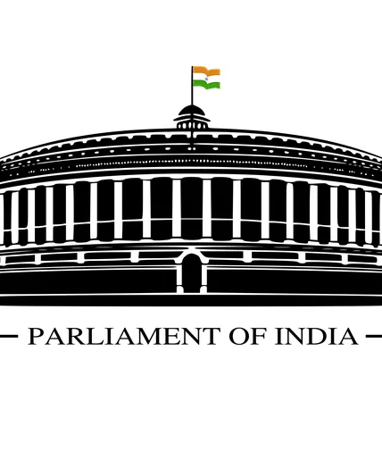
Introduction
The Parliament is the legislative organ of the Union
government.
It occupies a pre-eminent and central position in the Indian democratic political system due to adoption of the parliamentary form of government, also known as ‘Westminster’ model of government
Articles 79 to 122 in Part V of the Constitution deal with the organisation, composition, duration, officers, procedures, privileges, powers and so on of the Parliament.

Slide 3
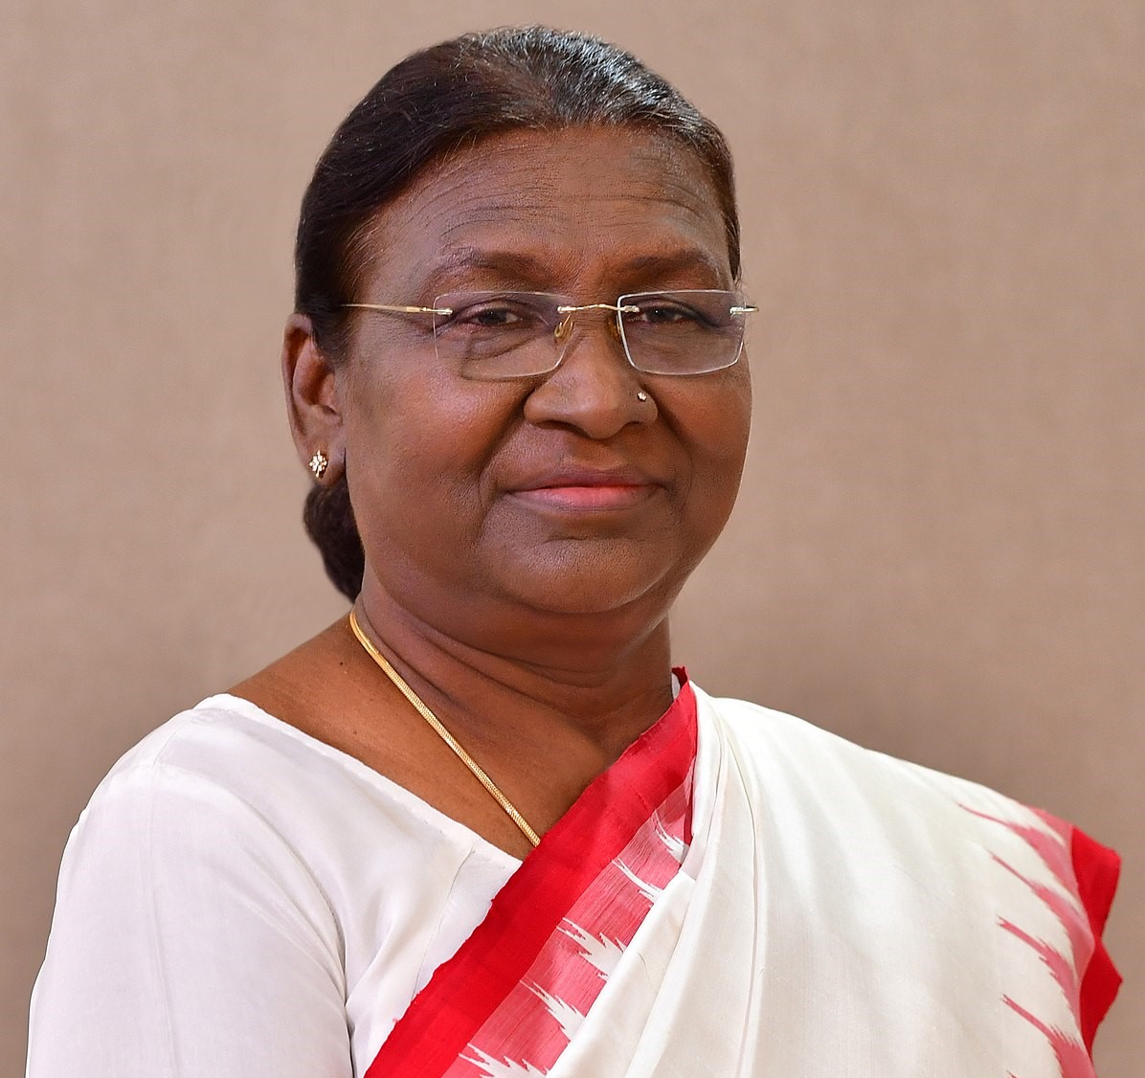
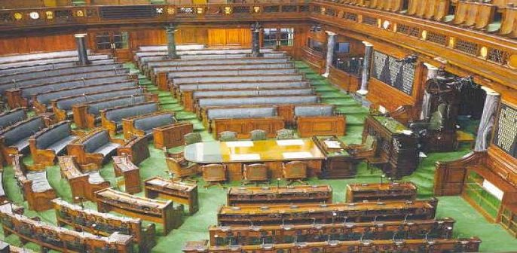
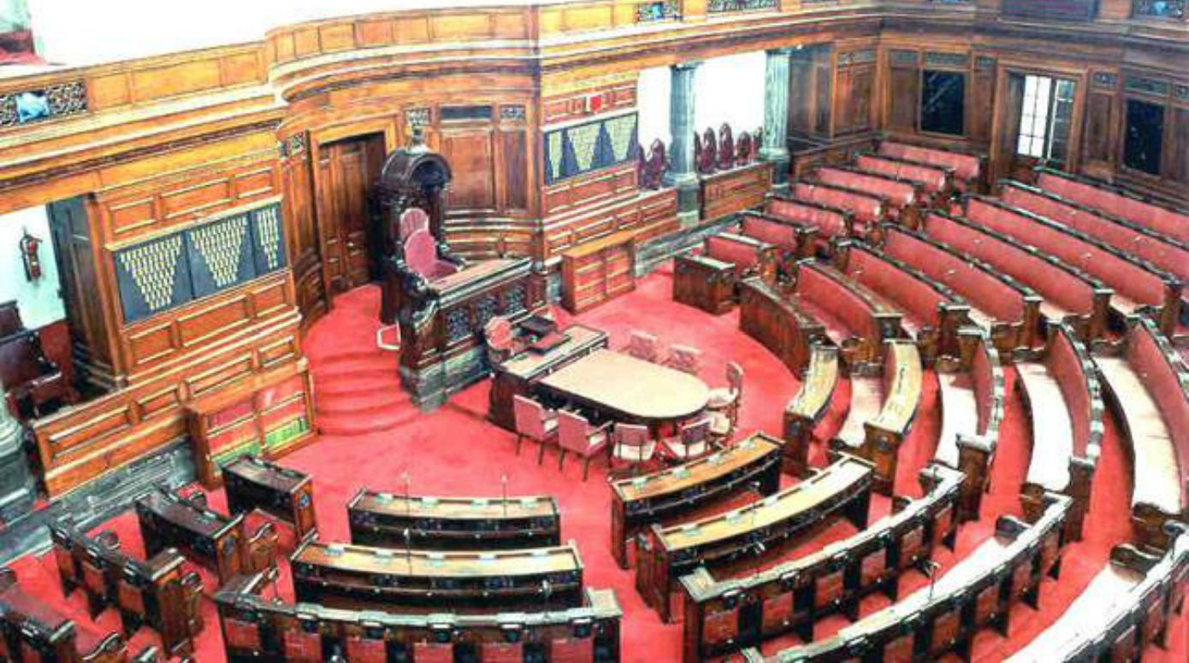
ORGANISATION OF PARLIAMENT
PRESIDENT
LOK SABHA
Under the Constitution, the Parliament of India consists of three parts
RAJYA SABHA

Slide 4
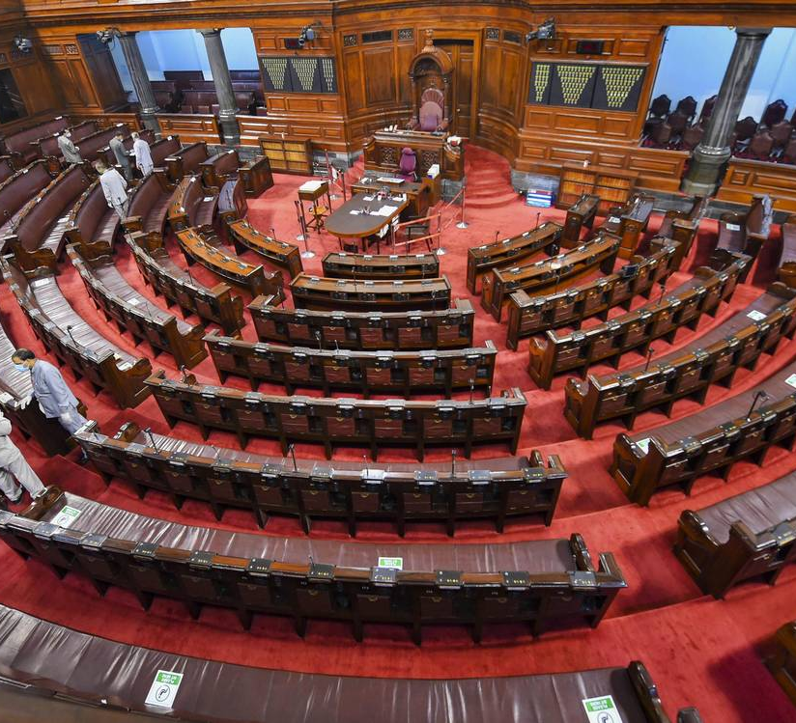
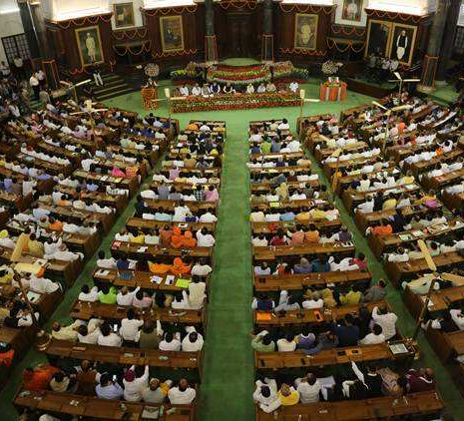
ORGANISATION OF PARLIAMENT
Under the Constitution, the Parliament of India consists of three parts viz, the President, the Council of States and the House of the People.
In 1954, the Hindi names ‘Rajya Sabha’ and ‘Lok Sabha’ were adopted by the Council of States and the House of People respectively.
The Rajya Sabha is the Upper House (Second Chamber or House of Elders) and the Lok Sabha is the Lower House (First Chamber or Popular House).

Slide 5
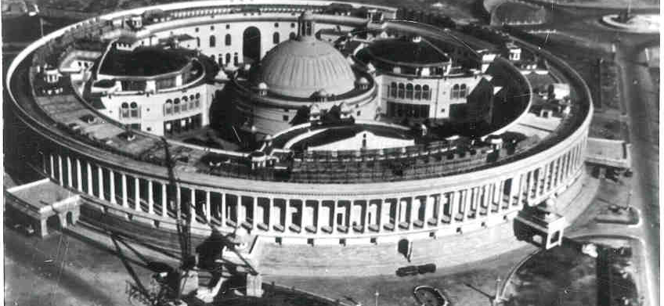
Composition of two Houses
Rajya Sabha
The maximum strength of the Rajya Sabha is fixed at 250, out of which, 238 are to be the representatives of the states and union territories (elected indirectly) and 12 are nominated by the president.
At present, the Rajya Sabha has 245 members. Of these, 229 members represent the states, 4 members represent the union territories and 12 members are nominated by the president.
The States are given proportionate representation according to their population. Thus, Uttar Pradesh has 31 seats, whereas Nagaland has only 1 seat.
“Persons having special knowledge in literature, science, art and social service shall be nominated by the President at his/her discretion.”
For e.g., MC Mary Kom (2016-22), Sachin Tendulkar (2012-2018), Dr. Satyendranath Bose (1952-1960), Lata Mangeshkar (1999-2005), Dr. MS Swaminathan (2017-2013), Javed Akhtar (2010-2016) etc.

Slide 6
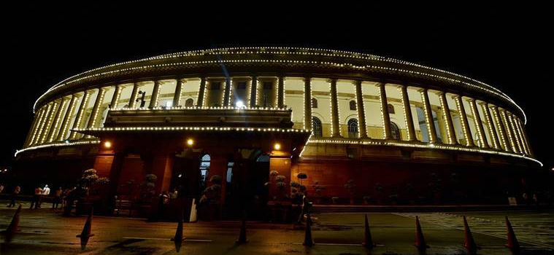
Composition of two Houses
Lok Sabha
The maximum strength of the Lok Sabha is fixed at 552. Out of this, 530 members are to be the representatives of the states, 20 members are to be the representatives of the union territories and 2 members are to be nominated by the president from the Anglo- Indian community
At present, the Lok Sabha has 545 members. Of these, 530 members represent the states, 13 members represent the union territories and 2 Anglo-Indian members are nominated by the President.
The representatives of states in the Lok Sabha are directly elected by the people from the territorial constituencies in the states.
“The president can nominate two members from the Anglo-Indian community if the community is not adequately represented in the Lok Sabha. Originally, this provision was to operate till 1960 but has been extended till 2020 by the 95th Amendment Act, 2009”

Slide 7
Qualification for Members
He must be a citizen of India.
He must make and subscribe to an oath or affirmation before the person authorised by the election commission for this purpose. In his oath or affirmation, he swears
To bear true faith and allegiance to the Constitution of India
To uphold the sovereignty and integrity of India
He must be not less than 30 years of age in the case of the Rajya Sabha and not less than 25 years of age in the case of the Lok Sabha.
He must posses other qualifications prescribed by Parliament.

Slide 8
Disqualification for Members
If he holds any office of profit under the Union or state government (except that of a minister or any other office exempted by Parliament).
If he is of unsound mind and stands so declared by a court
If he is not a citizen of India or has voluntarily acquired the citizenship of a foreign state or is under any acknowledgement of allegiance to a foreign state
If he is so disqualified under any law made by Parliament
If he is an undischarged insolvent

Slide 9
Disqualification for Members under 1oth Schedule
If he voluntary gives up the membership of the political party on whose ticket he is elected to the House
If he votes or abstains from voting in the House contrary to any direction given by his political party
Anti Defection Law
The Constitution also lays down that a person shall be disqualified from being a member of Parliament if he is so disqualified on the ground of defection under the provisions of the Tenth Schedule.
The Anti Defection law was passed in 1985 by 52nd Constitutional Amendment, which added the 10th Schedule of the Constitution.
The 91st Constitutional Amendment Act 2003 provided disqualification on the ground of defection not to apply in case of split.
The Power to disqualify a member rests with the Chairman or the Speaker of the house.
If any independently elected member joins any political party
If any nominated member joins any political party after the expiry of six months

Slide 10
Vacating of Seats
Double Membership: A person cannot be a member of both Houses of Parliament at the same time.
Disqualification: If a member of Parliament becomes subject to any of the disqualifications specified in the Constitution, his seat becomes vacant.
Resignation: A member may resign his seat by writing to the Chairman of Rajya Sabha or Speaker of Lok Sabha, as the case may be. The seat falls vacant when the resignation is accepted.
Absence: A House can declare the seat of a member vacant if he is absent from all its meetings for a period of sixty days without its permission. In computing the period of sixty days, no account shall be taken of any period during which the House is prorogued or adjourned for more than four consecutive days.
Other cases:
(a)if his election is declared void by the court;
(b) if he is expelled by the House;
(c) if he is elected to the office of President or Vice-President;
(d) if he is appointed to the office of governor of a state.

Slide 11
Salaries and Allowances
2018, the salary of members was increased from ₹50,000 to ₹1,00,000 per month, the constituency allowance from ₹45,000 to ₹70,000 per month and the office expenses allowance from ₹45,000 to ₹60,000 per month.
From 1976, the members are also entitled to a pension on a graduated scale for each five-year-term as members of either House of Parliament.
The salaries and allowances of the Speaker and Deputy Speaker of Lok Sabha and the Chairman and Deputy Chairman of Rajya Sabha are also determined by Parliament. They are charged on the Consolidated Fund of India and thus are not subject to the annual vote of Parliament.
Members of either House of Parliament are entitled to receive such salaries and allowances as may be determined by Parliament, and there is no provision of pension in the Constitution. However, Parliament has provided pension to the members.

Slide 12
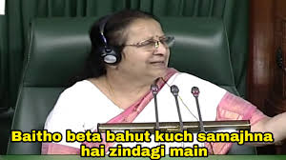
PRESIDING OFFICERS OF PARLIAMENT
Speaker
The Speaker is elected by the Lok Sabha from amongst its members (as soon as may be, after its first sitting).
The Speaker remains in its office during the life of the Lok Sabha. It vacates office earlier in any of the following cases:
If he ceases to be member of Lok Sabha;
If he resigns by writing to the Deputy Speaker;
If he is removed by a resolution passed by a majority of all the members of the Lok Sabha. Such a resolution can be moved only after giving 14 days advance notice.
Each House of Parliament has its own presiding officer. There is a Speaker and a Deputy Speaker for the Lok Sabha and a Chairman and a Deputy Chairman for the Rajya Sabha.

Slide 13
Functions, Roles and Powers of Speaker
The Speaker is the head of the Lok Sabha, and its representative. He is the guardian of powers and privileges of the members, the House as a whole and its committees. He is the principal spokesman of the House, and his decision in all Parliamentary matters is final.
He maintains order and decorum in the House for conducting its business and regulating its proceedings. This is his primary responsibility and he has final power in this regard.
He is the final interpreter of the provisions of (a) the Constitution of India, (b) the Rules of Procedure and Conduct of Business of Lok Sabha, and (c) the parliamentary precedents, within the House.
He adjourns the House or suspends the meeting in absence of a quorum. The quorum to constitute a meeting of the House is one-tenth of the total strength of the House.
He does not vote in the first instance. But he can exercise a casting vote in the case of a tie. In other words, only when the House is divided equally on any question, the Speaker is entitled to vote. Such vote is called casting vote, and its purpose is to resolve a deadlock.
He presides over a joint setting of the two Houses of Parliament. Such a sitting is summoned by the President to settle a deadlock between the two Houses on a bill.
He can allow a ‘secret’ sitting of the House at the request of the Leader of the House. When the House sits in secret, no stranger can be present in the chamber, lobby or galleries except with the permission of the Speaker.
He decides whether a bill is a money bill or not and his decision on this question is final. When a money bill is transmitted to the Rajya Sabha for recommendation and presented to the President for assent, the Speaker endorses on the bill his certificate that it is a money bill.
He decides the questions of disqualification of a member of the Lok Sabha, arising on the ground of defection under the provisions of the Tenth Schedule. In 1992, the Supreme Court ruled that the decision of the Speaker in this regard is subject to judicial review10 .
He acts as the ex-officio chairman of the Indian Parliamentary Group which is a link between the Parliament of India and the various parliaments of the world. He also acts as the ex-officio chairman of the conference of presiding officers of legislative bodies in the country.
He appoints the chairman of all the parliamentary committees of the Lok Sabha and supervises their functioning. He himself is the chairman of the Business Advisory Committee, the Rules Committee and the General Purpose Committee.

Slide 14
LEGISLATIVE PROCEDURE IN PARLIAMENT
The legislative procedure is identical in both the Houses of Parliament. Every bill has to pass through the same stages in each House. A bill is a proposal for legislation and it becomes an act or law when duly enacted.
The bills introduced in the Parliament can also be classified into four categories:
1. Ordinary bills, which are concerned with any matter other than financial subjects.
2. Money bills, which are concerned with the financial matters like taxation, public expenditure, etc.
3. Financial bills, which are also concerned with financial matters (but are different from money bills).
4. Constitution amendment bills, which are concerned with the amendment of the provisions of the Constitution.

Slide 15
DEVICES OF PARLIAMENTARY PROCEEDINGS
Question Hour
Zero Hour
Motions
Closure Motion
Privilege Motion
Calling Attention Motion
Adjournment Motion
No-Confidence Motion
Confidence Motion

Slide 16
DEVICES OF PARLIAMENTARY PROCEEDINGS
Question Hour
The first hour of every parliamentary sitting is slotted for this. During this time, the members ask questions and the ministers usually give answers. The questions are of three kinds, namely, starred, unstarred and short notice
A starred question (distinguished by an asterisk) requires an oral answer and hence supplementary questions can follow.
An unstarred question, on the other hand, requires a written answer and hence, supplementary questions cannot follow.
A short notice question is one that is asked by giving a notice of less than ten days. It is answered orally.

Slide 17
Zero Hour
Unlike the question hour, the zero hour is not mentioned in the Rules of Procedure. Thus it is an informal device available to the members of the Parliament to raise matters without any prior notice.
The zero hour starts immediately after the question hour and lasts until the agenda for the day (ie, regular business of the House) is taken up.
In other words, the time gap between the question hour and the agenda is known as zero hour. It is an Indian innovation in the field of parliamentary procedures and has been in existence since 1962.

Slide 18
Motions
No discussion on a matter of general public importance can take place except on a motion made with the consent of the presiding officer. The House expresses its decisions or opinions on various issues through the adoption or rejection of motions moved by either ministers or private members.

Slide 19
Closure Motion
It is a motion moved by a member to cut short the debate on a matter before the House. If the motion is approved by the House, debate is stopped forthwith and the matter is put to vote. There are four kinds of closure motions.
Simple Closure: It is one when a member moves that the ‘matter having been sufficiently discussed be now put to vote’.
Closure by Compartments: In this case, the clauses of a bill or a lengthy resolution are grouped into parts before the commencement of the debate. The debate covers the part as a whole and the entire part is put to vote.
Kangaroo Closure: Under this type, only important clauses are taken up for debate and voting and the intervening clauses are skipped over and taken as passed.
Guillotine Closure: It is one when the undiscussed clauses of a bill or a resolution are also put to vote along with the discussed ones due to want of time (as the time allotted for the discussion is over).

Slide 20
Privilege Motion
It is concerned with the breach of parliamentary privileges by a minister. It is moved by a member when he feels that a minister has committed a breach of privilege of the House or one or more of its members by withholding facts of a case or by giving wrong or distorted facts. Its purpose is to censure the concerned minister.

Slide 21
Calling Attention Motion
It is introduced in the Parliament by a member to call the attention of a minister to a matter of urgent public importance, and to seek an authoritative statement from him on that matter. Like the zero hour, it is also an Indian innovation in the parliamentary procedure and has been in existence since 1954. However, unlike the zero hour, it is mentioned in the Rules of Procedure.

Slide 22
Adjournment Motion
It is introduced in the Parliament to draw attention of the House to a definite matter of urgent public importance, and needs the support of 50 members to be admitted
As it interrupts the normal business of the House, it is regarded as an extraordinary device. It involves an element of censure against the government and hence Rajya Sabha is not permitted to make use of this device.
The discussion on an adjournment motion should last for not less than two hours and thirty minutes.

Slide 23
Adjournment Motion
The right to move a motion for an adjournment of the business of the House is subject to the following restrictions:
It should raise a matter which is definite, factual, urgent and of public importance;
It should not cover more than one matter;
It should be restricted to a specific matter of recent occurrence and should not be framed in general terms;
It should not raise a question of privilege;
It should not revive discussion on a matter that has been discussed in the same session;
It should not deal with any matter that is under adjudication by court; and
It should not raise any question that can be raised on a distinct motion.

Slide 24
No-Confidence Motion
Article 75 of the Constitution says that the council of ministers shall be collectively responsible to the Lok Sabha. It means that the ministry stays in office so long as it enjoys confidence of the majority of the members of the Lok Sabha. In other words, the Lok Sabha can remove the ministry from office by passing a noconfidence motion. The motion needs the support of 50 members to be admitted.

Slide 25
Motion of Thanks
The first session after each general election and the first session of every fiscal year is addressed by the president. In this address, the president outlines the policies and programmes of the government in the preceding year and ensuing year. This address of the president, which corresponds to the ‘speech from the Throne in Britain’, is discussed in both the Houses of Parliament on a motion called the ‘Motion of Thanks’. At the end of the discussion, the motion is put to vote. This motion must be passed in the House. Otherwise, it amounts to the defeat of the government. This inaugural speech of the president is an occasion available to the members of Parliament to raise discussions and debates to examine and criticise the government and administration for its lapses and failures

Slide 26
Quorum
Quorum is the minimum number of members required to be present in the House before it can transact any business. It is one-tenth of the total number of members in each House including the presiding officer.
It means that there must be at least 55 members present in the Lok Sabha and 25 members present in the Rajya Sabha, if any business is to be conducted. If there is no quorum during a meeting of the House, it is the duty of the presiding officer either to adjourn the House or to suspend the meeting until there is a quorum.

Slide 27
Leader of the House
Under the Rules of Lok Sabha, the ‘Leader of the House’ means the prime minister, if he is a member of the Lok Sabha, or a minister who is a member of the Lok Sabha and is nominated by the prime minister to function as the Leader of the House.
There is also a ‘Leader of the House’ in the Rajya Sabha. He is a minister and a member of the Rajya Sabha and is nominated by the prime minister to function as such.
The leader of the house in either House is an important functionary and exercises direct influence on the conduct of business. He can also nominate a deputy leader of the House. The same functionary in USA is known as the ‘majority leader’.

Slide 28
Leader of the Opposition
In each House of Parliament, there is the ‘Leader of the Opposition’. The leader of the largest Opposition party having not less than one-tenth seats of the total strength of the House is recognised as the leader of the Opposition in that House.
In a parliamentary system of government, the leader of the opposition has a significant role to play. His main functions are to provide a constructive criticism of the policies of the government and to provide an alternative government.
Therefore, the leader of Opposition in the Lok Sabha and the Rajya Sabha were accorded statutory recognition in 1977. They are also entitled to the salary, allowances and other facilities equivalent to that of a cabinet minister. It was in 1969 that an official leader of the opposition was recognised for the first time.

Slide 29
Whip
Though the offices of the leader of the House and the leader of the Opposition are not mentioned in the Constitution of India, they are mentioned in the Rules of the House and Parliamentary Statute respectively. The office of ‘whip’, on the other hand, is mentioned neither in the Constitution of India nor in the Rules of the House nor in a Parliamentary Statute. It is based on the conventions of the parliamentary government.
Every political party, whether ruling or Opposition has its own whip in the Parliament. He is appointed by the political party to serve as an assistant floor leader. He is charged with the responsibility of ensuring the attendance of his party members in large numbers and securing their support in favour of or against a particular issue. He regulates and monitors their behaviour in the Parliament. The members are supposed to follow the directives given by the whip. Otherwise, disciplinary action can be taken.

Slide 30
Before we wrap up…..
In Parliament house, the room no for President’s Office is no. 13. Next time you feel something unlucky for its no 13 just recall the room no of President of India.
The first floor balcony has a total of 144 pillars.
Both Lok Sabha and Rajya Sabha halls are horseshoe-shaped.
Cost per minute of Parliament working during session cost 2.5 lakh.
Approximately around 12 in the noon the Members of Parliament are allowed to discuss any prominent issue that needs special consideration with prior notice to Speaker of the House. Zero Hour is the crucial part of the whole session that may question working of Government or ask about their policies regarding different issues.

Slide 31

Thank You

